Slide 1


Stanislaus Mangalathas Joshua
04.06.2025

Slide 2

Outline
Executive Summary
Introduction
Methodology
Results
Conclusion
Appendix

Slide 3
Executive Summary
• The following methodologies were used to analyze data: Data Collection using web scraping and SpaceX API; Exploratory Data Analysis (EDA), including data wrangling, data visualization and interactive visual analytics; Machine Learning Prediction.
• Summary of all results It was possible to collected valuable data from public sources; EDA allowed to identify which features are the best to predict success of launchings; Machine Learning Prediction showed the best model to predict which characteristics are important to drive this opportunity by the best way, using all collected data.

Slide 4
Introduction
• The objective is to evaluate the viability of the new company SpaceY to compete with Space X.
• Desirable answers:
• The best way to estimate the total cost for launches, by predicting successful landings of the first stage of rockets;
• Where is the best place to make launches.

Slide 5

Section 1

Slide 6
Methodology
Executive Summary
Data collection methodology:
• Data from Space X was obtained from 2 sources:
• SpaceX API (https://api.spacexdata.com/v 4/rockets/)
• Web Scraping (https://en.wikipedia.org/wiki/List_of_Falcon/_9/_and_Falcon_Heavy_launches)
Perform data wrangling
• Collected data was enriched by creating a landing outcome label based on outcome data after summarizing and analyzing features

Slide 7
Methodology
Executive Summary
Perform exploratory data analysis (EDA) using visualization and SQL
Perform interactive visual analytics using Folium and Plotly Dash
Perform predictive analysis using classification models
Data that was collected until this step were normalized, divided in training and test data sets and evaluated by four different classification models, being the accuracy of each model evaluated using different combinations of parameters.

Slide 8
Data Collection
Data sets were collected from Space XAPI (https://api.spacexdata.com/v 4/rockets/) and from Wikipedia
(https://en.wikipedia.org/wiki/List_of_Falcon/_ 9/_and_Falcon_Heavy_launches), using web scraping technics.

Slide 9
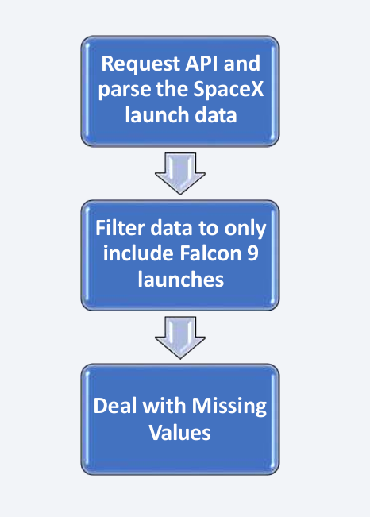
Data Collection – SpaceX API
SpaceX offers a public API from where data can be obtained and then used;
This API was used according to the flowchart beside and then data is persisted.
Source Code - Applied-Data-Science-Capstone/jupyter-labs-spacex-data-collection-api.ipynb at main · JOSHcaleb/Applied-Data-Science-Capstone

Slide 10
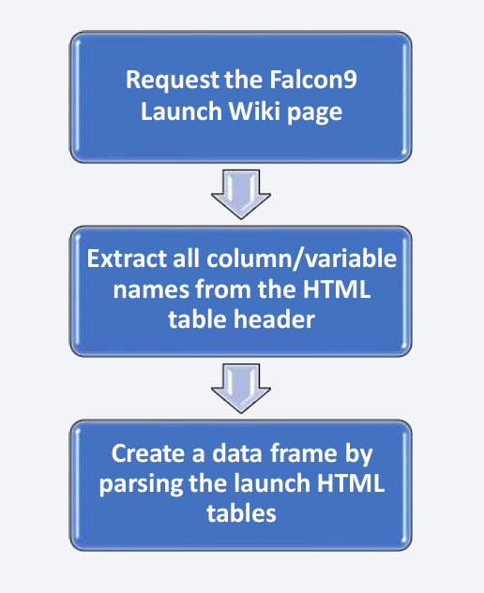
Data Collection - Scraping
Data from SpaceX launches can also be obtained from Wikipedia;
• Data are downloaded from Wikipedia according to the flowchart and then persisted.
Source Code - Applied-Data-Science-Capstone/Hands-on Lab_ Data Collection with Web Scraping.ipynb at main · JOSHcaleb/Applied-Data-Science-Capstone

Slide 11
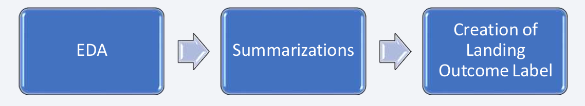
Data Wrangling
• Initially some Exploratory Data Analysis (EDA) was per formed on the dataset.
• Then the summaries launches per site, occurrences of each orbit and occurrences of mission outcome per orbit type were calculated.
• Finally, the landing outcome label was created from Outcome column.
Source code - Applied-Data-Science-Capstone/Hands-On Lab_ Data Wrangling.ipynb at main · JOSHcaleb/Applied-Data-Science-Capstone

Slide 12
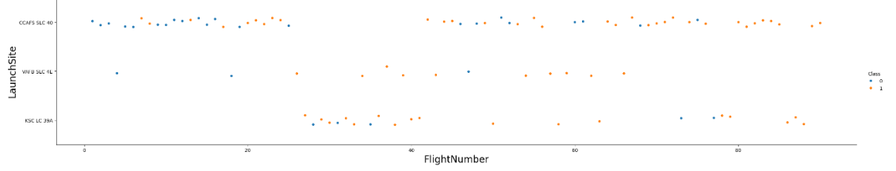
EDA with Data Visualization
To explore data, scatterplots and barplots were used to visualize the relationship between pair of features:
• Payload MassXFlight Number, LaunchSite XFlight Number, LaunchSite XPayload Mass, Orbit and Flight Number, Payload and Orbit
Source code - Applied-Data-Science-Capstone/Hands-On Lab_ Data Wrangling.ipynb at main · JOSHcaleb/Applied-Data-Science-Capstone

Slide 13
EDA with SQL
The following SQL queries were performed:
• Names of the unique launch sites in the space mission;
• Top5 launch sites whose name begin with the string 'CCA’;
• Total payload mass carried by boosters launched by NASA (CRS);
• Average payload mass carried by booster version F9 v1.1;
• Date when the first successful landing outcome in ground pad was achieved;
• Names of the boosters which have success in drone ship and have payload mass between 4000 and 6000 kg;
• Total number of successful and failure mission outcomes;
• Names of the booster versions which have carried the maximum payload mass;
• Failed landing outcomes in drone ship, their booster versions, and launch site names for in year 2015; and
• Rank of the count of landing outcomes (such as Failure (drone ship) or Success(ground pad)) between the date 2010-06-04 and 2017-03-20.
Source code - Applied-Data-Science-Capstone/Hands-on Lab Complete the EDA with SQL.ipynb at main · JOSHcaleb/Applied-Data-Science-Capstone

Slide 14
Build an Interactive Map with Folium
Markers, circles, lines and marker clusters were used with Folium Maps
Markers indicate points like launch sites;
Circles indicate highlighted areas around specific coordinates, like NASA Johnson Space Center;
Marker clusters indicates groups of events in each coordinate, like launches in a launch site; and
Lines are used to indicate distances between two coordinates.
Source code - Applied-Data-Science-Capstone/lab_jupyter_launch_site_location.ipynb at main · JOSHcaleb/Applied-Data-Science-Capstone

Slide 15
Build a Dashboard with Plotly Dash
The following graphs and plots were used to visualize data
Percentage of launches by site
Payload range
• This combination allowed to quickly analyze the relation between payloads and launch sites, helping to identify where is best place to launch according to payloads.
Source code - Applied-Data-Science-Capstone/Hands-on Lab_ Build an Interactive Dashboard with Ploty Dash (1).ipynb at main · JOSHcaleb/Applied-Data-Science-Capstone

Slide 16
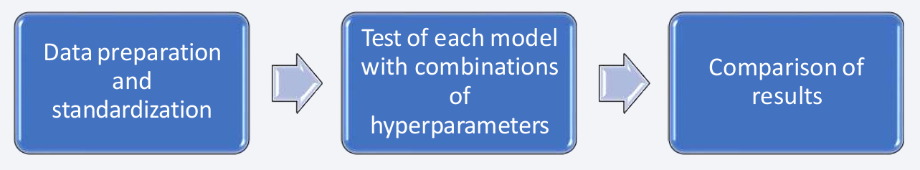
Predictive Analysis (Classification)
Four classification models were compared: logistic regression, support vector machine, decision tree and k nearest neighbors.
Source code - Applied-Data-Science-Capstone/SpaceX_Machine Learning Prediction_Part_5.ipynb at main · JOSHcaleb/Applied-Data-Science-Capstone

Slide 17
Results
Exploratory data analysis results
• SpaceX uses 4 different launch sites;
• The first launches were done to SpaceX itself and NASA;
• The average payload of F9 v1.1 booster is 2,928 kg;
• The first success landing outcome happened in 2015 fiver year after the first launch;
• Many Falcon 9 booster versions were successful at landing in drone ships having payload above the average;
• Almost 100% of mission outcomes were successful;
• Two booster versions failed at landing in drone ships in 2015: F9 v1.1 B1012 and F9 v1.1 B1015;
• The number of landing outcomes became as better as years passed.

Slide 18
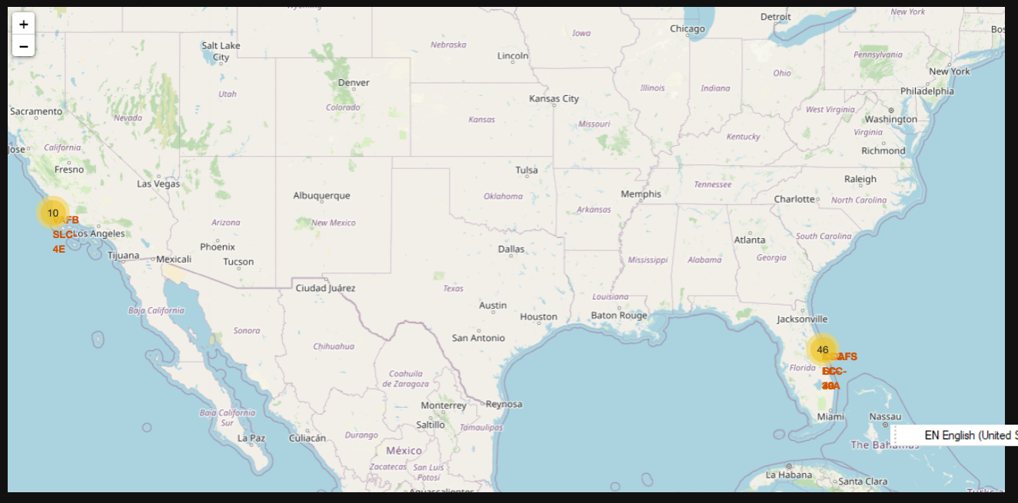
Results
Using interactive analytics was possible to identify that launch sites use to be in safety places, near sea, for example and have a good logistic infrastructure around.
• Most launches happens at east cost launch sites.

Slide 19
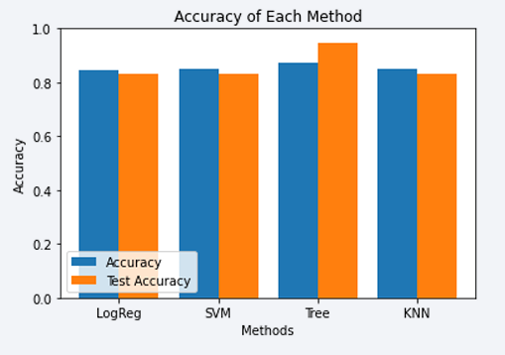
Results
Predictive Analysis showed that Decision Tree Classifier is the best model to predict successful landings, having accuracy over 87% and accuracy for test data over 94%.

Slide 20

Section 2

Slide 21
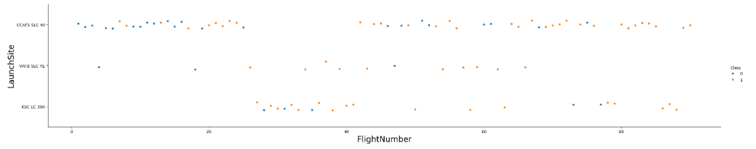
Flight Number vs. Launch Site
According to the plot above, it’s possible to verify that the best launch site nowadays is CCAF5 SLC40, where most of recent launches were successful;
• In second place VAFB SLC4E and third place KSCLC 39A;
• It’s also possible to see that the general success rate improved over time.

Slide 22
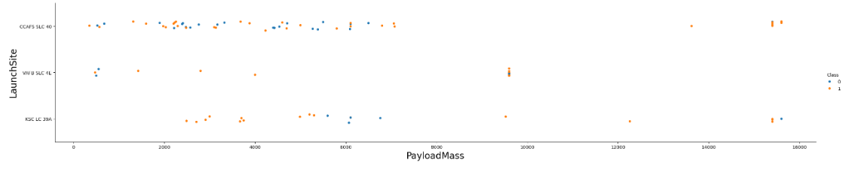
Payload vs. Launch Site
Payloads over 9,000kg (about the weight of a school bus) have excellent success rate;
• Payloads over 12,000kg seems to be possible only on CCAFSSLC40 and KSC LC 39A launch sites.

Slide 23
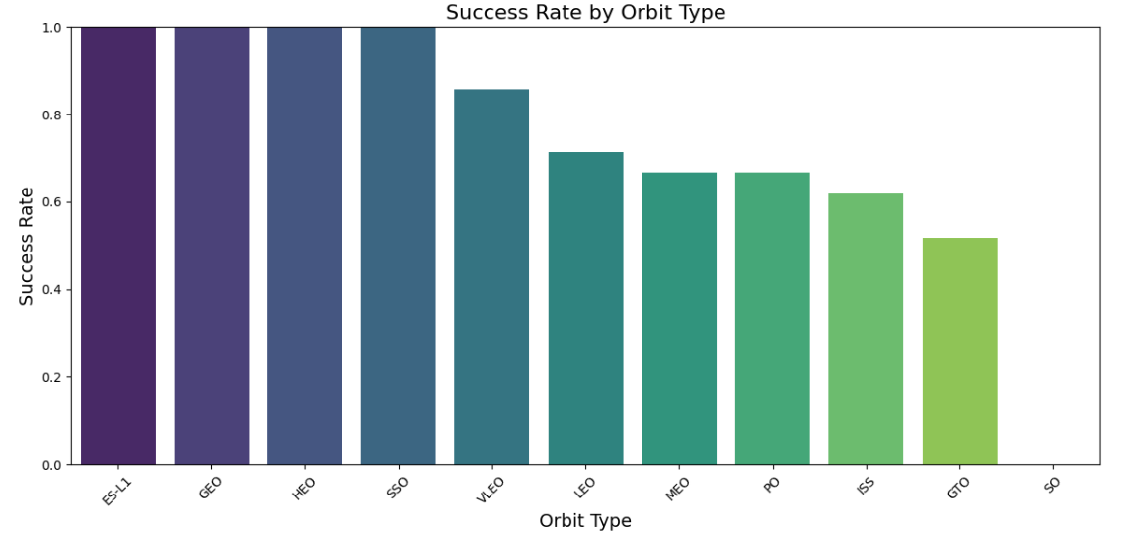
Success Rate vs. Orbit Type
The biggest success rates happens to orbits:
ES-L1;
GEO;
HEO; and
SSO.
Followed by:
VLEO(above80%); and
LFO(above70%).

Slide 24
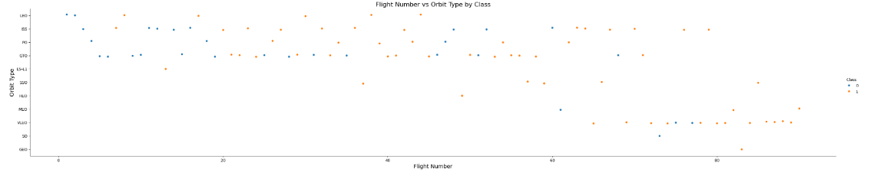
Flight Number vs. Orbit Type
Apparently, success rate improved over time to all orbits;
• VLEOorbit seemsanew business opportunity, due to recent increase of its frequency.

Slide 25
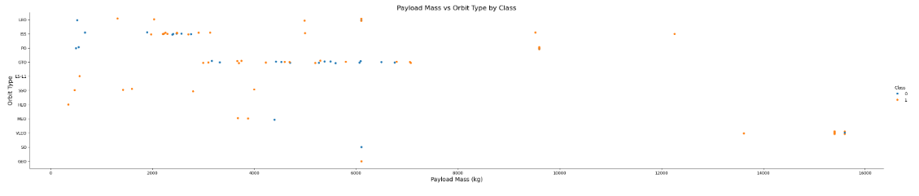
Payload vs. Orbit Type
Apparently, there is no relation between payload and success rate to orbit GTO;
• ISS orbit has the widest range of payload and a good rate of success;
• There are few launches to the orbits SO and GEO.

Slide 26
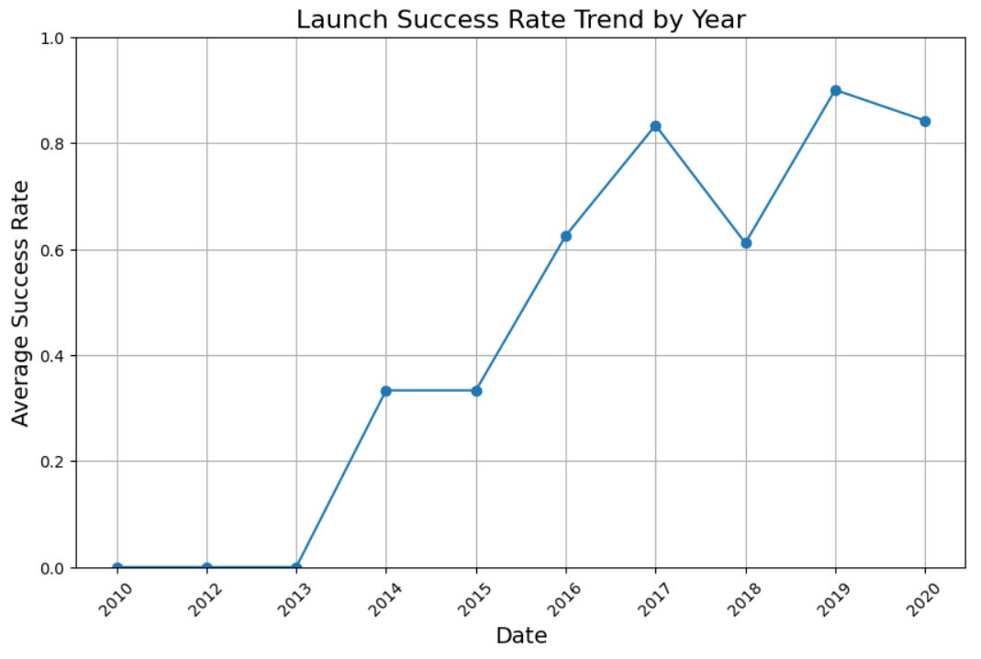
Launch Success Yearly Trend
Success rate started increasing in 2013 and kept until 2020;
• It seems that the first three years were a period of adjusts and improvement of technology.

Slide 27
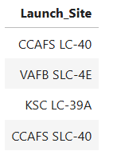
All Launch Site Names
According to data, there are four launch sites:
They are obtained by selecting unique occurrences of “launch_site” values from the dataset.
%sql select distinct Launch_Site from SPACEXTABLE;

Slide 28
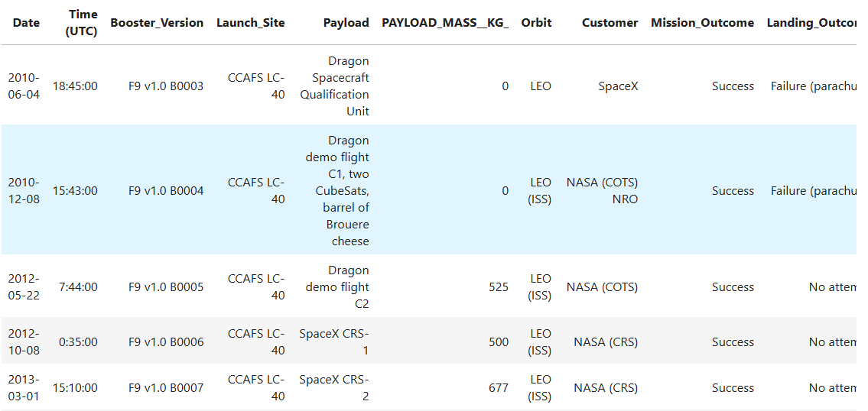
Launch Site Names Begin with 'CCA'
Here we can see five samples of Cape Canaveral launches.

Slide 29
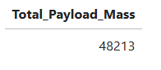
Total Payload Mass
the total payload carried by boosters from NASA
Total payload calculated above, by summing all payloads whose codes contain ‘CRS’, which corresponds to NASA.

Slide 30
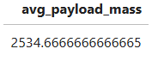
Average Payload Mass by F9 v1.1
the average payload mass carried by booster version F9 v1.1
Filtering data by the booster version above and calculating the average payload mass we obtained the value of 2,534.6 kg.

Slide 31
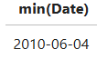
First Successful Ground Landing Date
the dates of the first successful landing outcome on ground pad
By filtering data by successful landing outcome on ground pad and getting the minimum value for date it’s possible to identify the first occurrence, that happened on 04/06/2010.

Slide 32
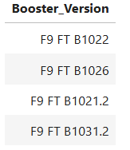
Successful Drone Ship Landing with Payload between 4000 and 6000
List the names of boosters which have successfully landed on drone ship and had payload mass greater than 4000 but less than 6000
Selecting distinct booster versions according to the filters above, these 4 are the result.

Slide 33
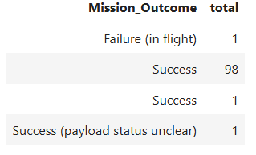
Total Number of Successful and Failure Mission Outcomes
the total number of successful and failure mission outcomes
Grouping mission outcomes and counting records for each group led us to the summary above.

Slide 34
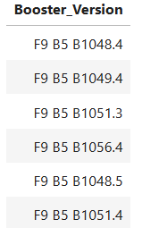
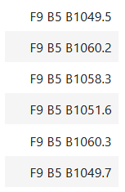
Boosters Carried Maximum Payload
the names of the booster which have carried the maximum payload mass
These are the boosters which have carried the maximum payload mass registered in the dataset.

Slide 35
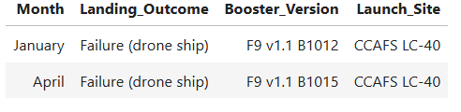
2015 Launch Records
List the failed landing_outcomes in drone ship, their booster versions, and launch site names for in year 2015
The list above has the only two occurrences.

Slide 36
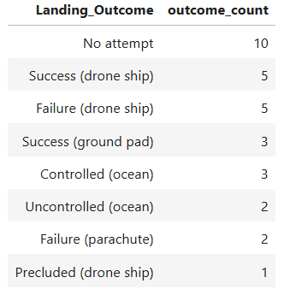
Rank Landing Outcomes Between 2010-06-04 and 2017-03-20
Rank the count of landing outcomes (such as Failure (drone ship) or Success (ground pad)) between the date 2010-06-04 and 2017-03-20, in descending order
This view of data alerts us that “No attempt” must be taken in account.

Slide 37

Section 3

Slide 38
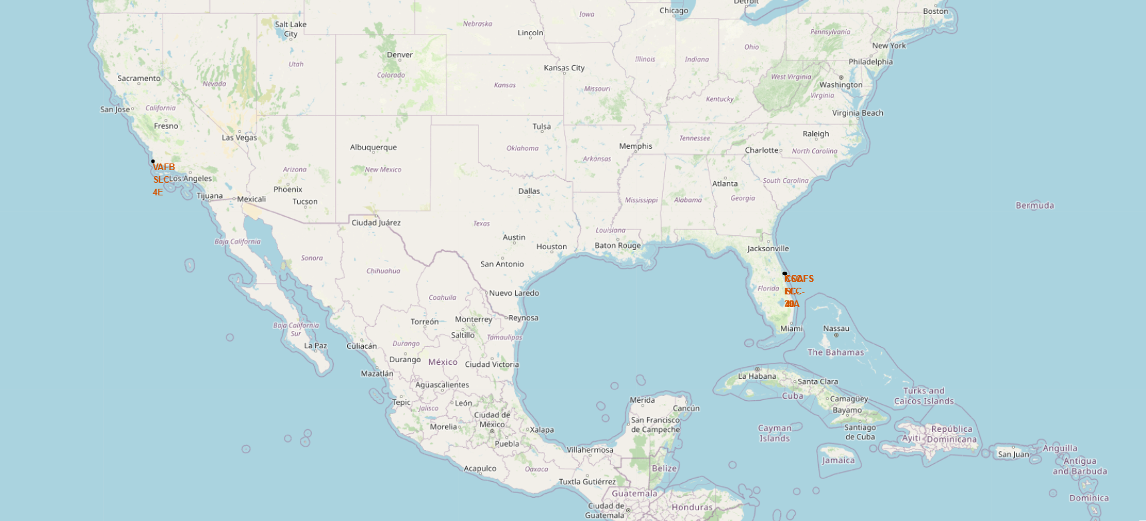
All launch sites
Launch sites are near sea, probably by safety, but not too far from roads and railroads.

Slide 39
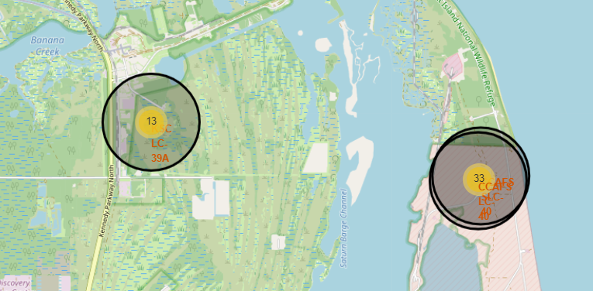
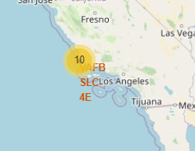
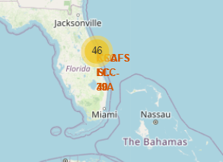
Launch Outcomes by Site
Example of KSC LC-39A launch site launch outcomes
Green markers indicate successful and red ones indicate failure

Slide 40
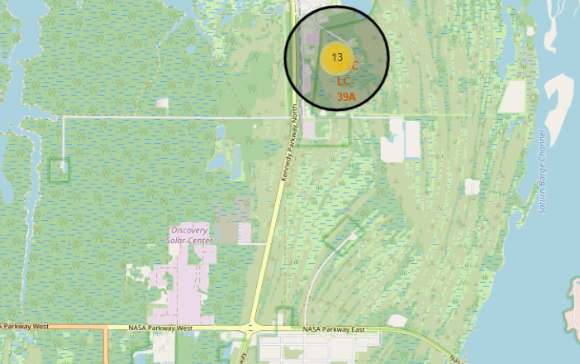
Logistics and Safety
Launch site KSCLC-39A has good logistics aspects, being near railroad and road and relatively far from inhabited areas.

Slide 41

Section 4

Slide 42
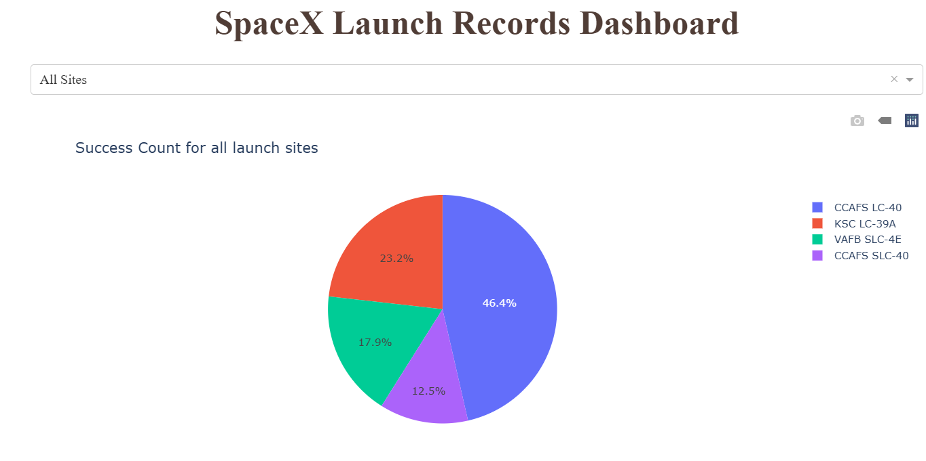
Successful Launches by Site
The place from where launches are done seems to be a very important factor of success of missions.

Slide 43
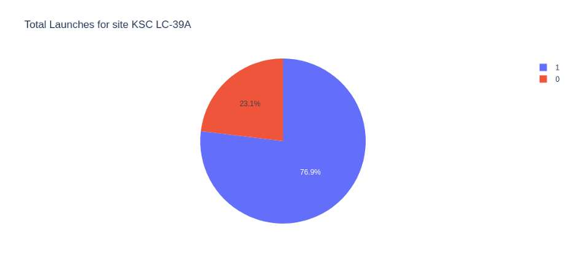
Launch Success Ratio for KSCLC-39A
76.9% of launches are successful in this site.

Slide 44
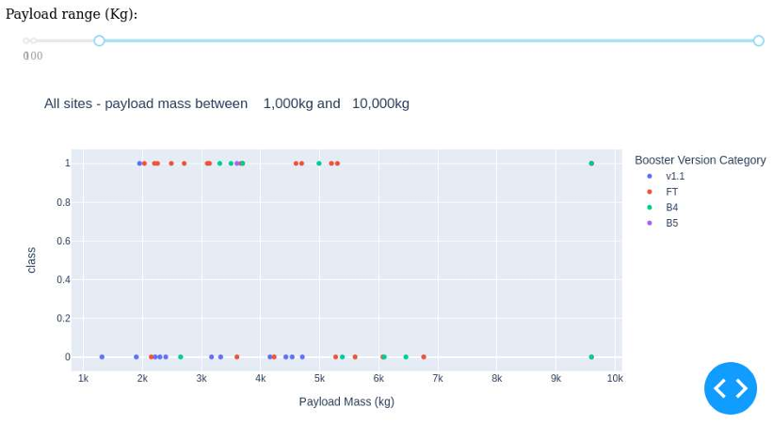
Payload vs. Launch Outcome
Payloads under 6,000kg and FT boosters are the most successful combination.

Slide 45

Section 5

Slide 46
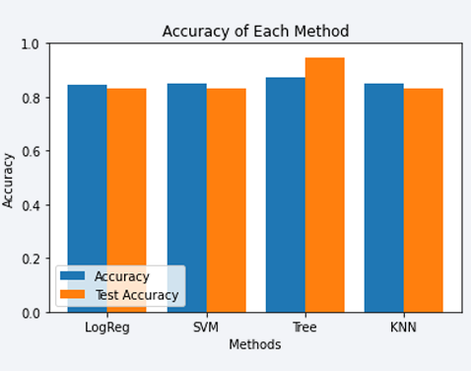
Classification Accuracy
Four classification models were tested, and their accuracies are plotted beside;
The model with the highest classification accuracy is Decision Tree Classifier, which has accuracies over than 87%

Slide 47
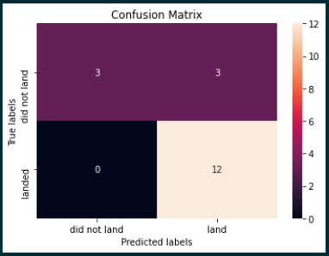
Confusion Matrix of Decision Tree Classifier
Confusion matrix of Decision Tree Classifier proves its accuracy by showing the big numbers of true positive and true negative compared to the false ones.

Slide 48
Conclusions
Different data sources were analyzed, refining conclusions along the process;
• The best launch site is KSCLC-39A;
• Launches above 7,000kg are less risky;
• Although most of mission outcomes are successful, successful landing outcomes seem to improve over time, according the evolution of processes and rockets;
• Decision Tree Classifier can be used to predict successful landings and increase profits.

Slide 49
Appendix
As an improvement for model tests, it’s important to set a value to np.random.seed variable;
• Folium didn’t show maps on Github, so I took screenshots.

Slide 50


